Slide 1

Bacchus Winery
TEAM BRAVO

Slide 2

Team Intro

Slide 3
Alexander Campbell
My name is Alexander Campbell, I am medically retired from the United States Army. I reside in Central time zone. I have been on call/working long shifts for a few weeks, so my availability has been sporadic. My phone number is 850-982-2932 if I need to be reached.

Slide 4
Steffan Hinkle
My name is Steffan, I am an Active Duty, married with a few dogs. Based on Eastern Time, I generally get off work around 6:30pm. Due to my job, I cannot guarantee I will be reachable during business hours but will always have access after. My cell is 4173091811.

Slide 5
Denae LunA
I'm Denae. Active Duty mom of 2 skin babies and 2 fur babies, happily married, neurodivergent, and always up for an adventure.
I'm on the West Coast (sorry y'all). I don't get off work until 1700PST (7:00PM CST) weekdays, but I don't mind getting up early until I have to go to work at 0700PST (9:00AM CST). I'm very available on the weekend and my cell in case you need me is: 4027630097.

Slide 6
Rogelio Orozco
My name's Rogelio – I'm a 24 years old and live in the Southwest. It's insanely hot here, with temperatures reaching the 120's.
I'm married and have two wonderful dogs. My hobbies include reading and writing music, Magic the Gathering and cooking.

Slide 7
Abhishek Upadhyaya
Hello everyone, my name is Abhishek K Upadhyaya, I live in Little Elm Texas. I am also a working IT professional and generally available after 5pm CST until midnight (I know I work very late almost everyday :-)). I can be reached on my cell 469-865-9318 or on MS Teams most of the time during daytime.

Slide 8
Case Study - Bacchus Winery

Slide 9
Bacchus Winery
Stan and Davis Bacchus inherited their winery from their father
They want to incorporate new business methods to help them improve their products and customer service
They do want to keep all existing personnel in place, hoping to effect minimum change during the turnover
Stan and Davis are responsible for keeping track of the supply inventory and would like to find a more efficient method of keeping track and ordering supplies, perhaps over the internet
Maria, who is responsible for distribution, would like their distributors to be able to order online, and to be able to track shipments

Slide 10
Group Ord

Slide 11
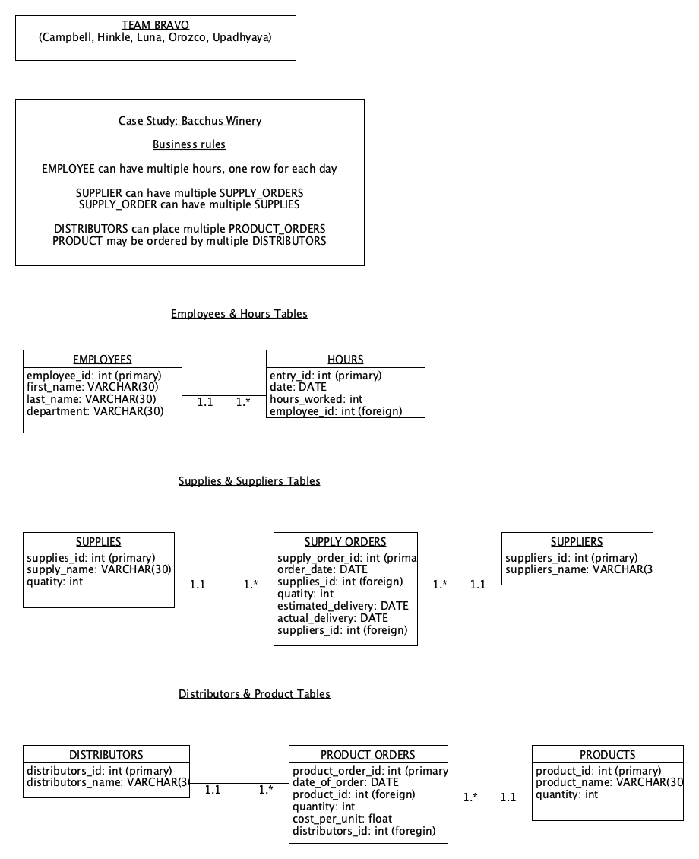
Employees & Hours Tables
Business Rule
EMPLOYEE can have multiple hours, one row for each day

Slide 12
Supplies & Suppliers Tables
Business Rules
SUPPLIER can have multiple SUPPLY_ORDERS
SUPPLY_ORDER can have multiple SUPPLIES

Slide 13
Distributors & Product Tables
Business Rules
DISTRIBUTORS can place multiple PRODUCT_ORDERS
PRODUCT may be ordered by multiple DISTRIBUTORS

Slide 14
Reports

Slide 15
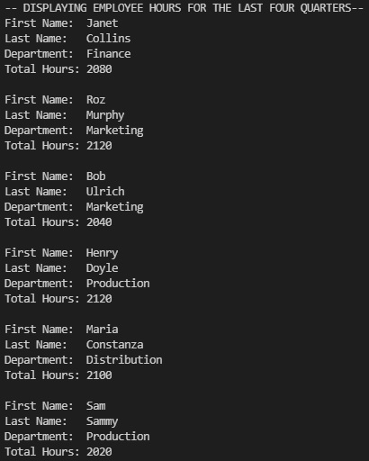
Employee time: During the last four quarters, how many hours did each employee work?
This report prints list of all employees with number of hours worked with in a month. Each block represents a single employee’s records with first name, last name, department and number of hours worked.

Slide 16
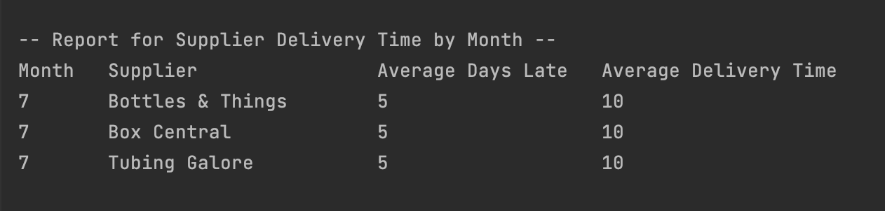
Supplier Delivery Time by Month
This report prints average number of days a supplier has taken to deliver supplies along with average number of days taken to complete the delivery

Slide 17
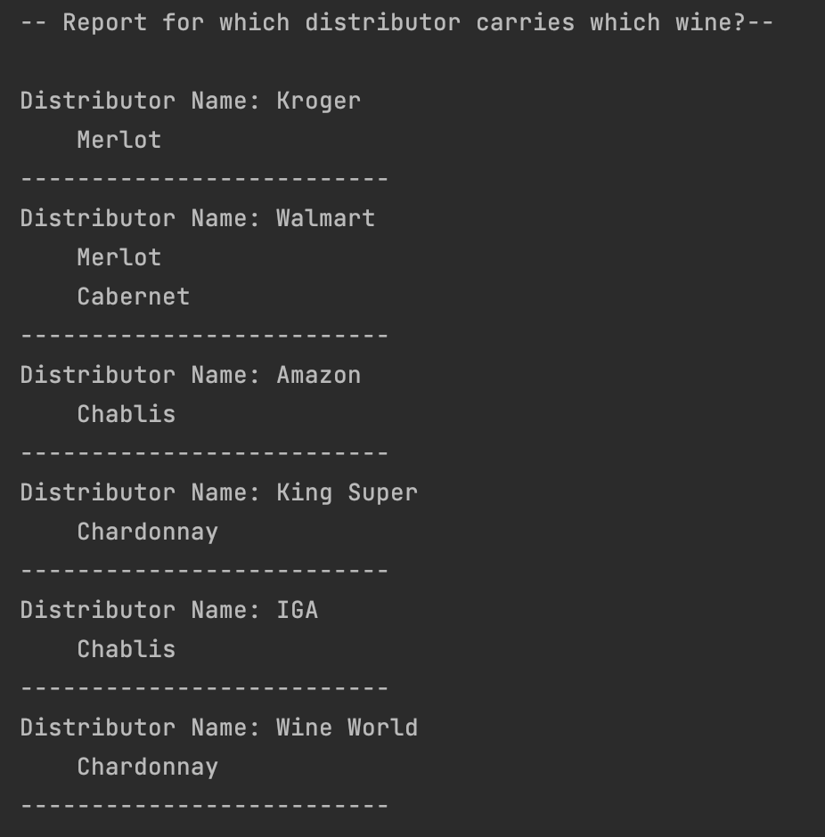
Report 3: Which distributor carries which wine?

Slide 18
Report 3: Which distributor carries which wine?
This is first report on the third point of the use case, this prints all the wines sold by registered distributors.

Slide 19
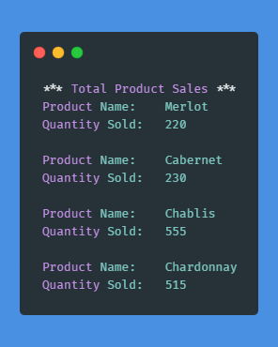
Report 3: Product Sales
This report shows sales of every product, this can be used to find out which product is doing good and which product requires focus.

Slide 20
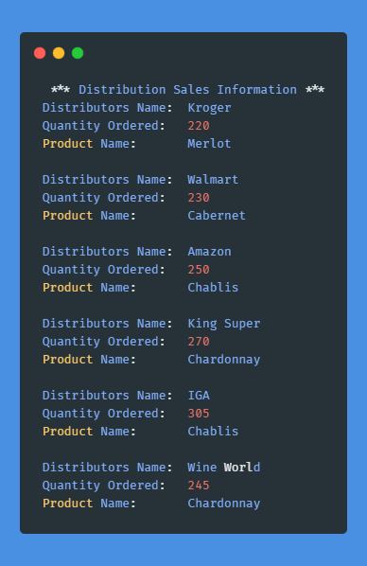
Report 3: Product Sales by distributors
This report shows how many products has a distributor ordered. In this report, name of the distributor, quantity and name of the product ordered is printed.

Slide 21
Assumptions
Shipping of Material occurs monthly or less.
Salary and hourly wage information is not required for this assignment only the time

